Slide 1
SuperStore Performance Analysis
Collin Maccabe

Slide 2
Exploratory Questions
What Regions are experiencing the most sales?
What are the average sales per Region?
What order categories are the most popular?
How are orders being processed?
What is the total revenue? Profit?
How have sales been trending month to month? Year to year?

Slide 4
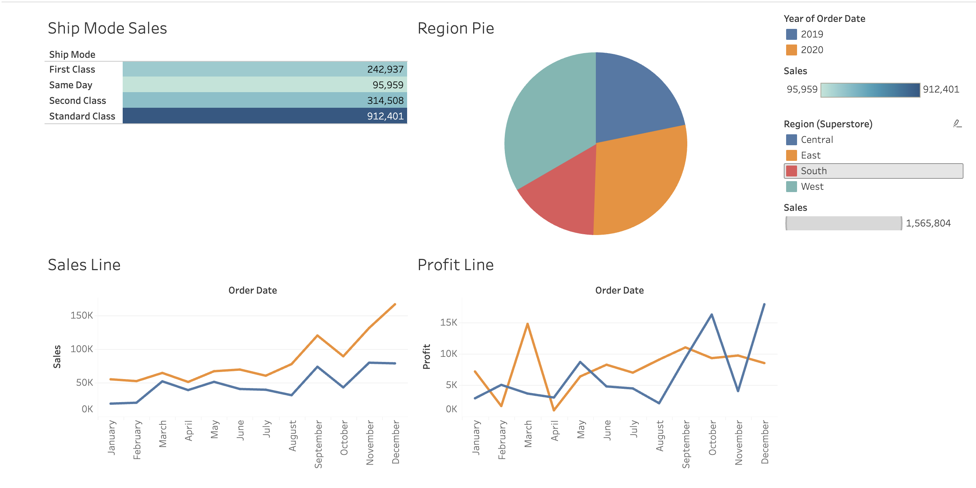
Tableau Visualization

Slide 5
Summary
For this superstore, ecommerce seems to play a profitable role in the business. We can conclude that the majority of sales are office supplies, more sales are generated in the West Region, and the preferred payment type is COD. It makes sense that like many retail companies, sales increase around the end of the year (holiday season).
Recommendations: In order to better target consumers, its possible that more advertising can be spent in the Western region and at the end of the year. Office supplies are the bread and butter for sales volume and total revenue generation. Additionally, highlighting the ease of order processing may be a key target for consumers.

